Slide 1
Overview
Red Hat JBoss

Slide 2
Current Architecture
Application Server
Teiid
Data Virtualization
- Virtual Data Base definition
> Data source schema definition
> View model transformations
- VDB represents “catalog”
- Translators > DB-specific data
- Query plan development & execution
- Data access via JDBC call
JNDI Data Sources (-ds.xml)
Translators
VDBs
Data Sources

Slide 3
Current Architecture
JBoss Developer Studio
Teiid Designer
Modeling
- VDB development and management
> source model definition
> view model transformations
> data roles (security, data access)
- Testing VDBs
- Query plan analysis
Models
VDBs
.xmi files
Import
JDBC
DDL
WSDL
etc...
Eclipse Data Tools
Connection Profiles

Slide 4
Current Architecture
JBoss Developer Studio
Application Server
Teiid Designer
Teiid
Teiid Admin API
JNDI Data Sources (-ds.xml)
Models
VDBs
deploy VDB
create or select -ds.xml
select translator
deploy data source
Translators
.xmi files
VDBs
Import
JDBC
DDL
WSDL
etc...
Teiid JDBC
Connection
Eclipse Data Tools
Test/Query
Connection Profiles
Data Sources

Slide 5
History
MetaMatrix - Modeler
  Java
  Versions 1 thru 2 - JLoox and Swing
    custom metamodels
  Versions 3 thru 5 – Eclipse/Draw-2d/EMF
    E-core/EMF metamodels
JBoss - Teiid Designer
  Versions 6 thru 8 – Eclipse/Draw-2d/EMF
    E-core/EMF metamodels
  8.3 Final due in 2013 Q4
  Follow-on 8.x releases to support Teiid 8.6+ releases

Slide 6
Legacy Tooling Issues
Large model support
  EMF metamodel is heavy-weight
  100% in-memory
VDB artifact is heavyweight
  XMI models
  Indexed metadata files for each model
  Teiid runtime requires index conversion to runtime metadata
Testing Limitations
  Eclipse-only UI
  Modeling engine/logic interwoven with UI
  Larger test coverage requires SWTBot/Plugin tests

Slide 7
Komodo Vision
Large model support
  Replace EMF with DDL metamodel
  Utilize Modeshape DDL parsing/sequencing
  Leverage Polyglotter modeling engine development
VDB-centric modeling
  Lighter-weight VDB archive
  Replace XMI/EMF models with Teiid dialect DDL files
  DDL files ARE indexed metadata and compatible with Teiid Runtime/engine (i.e. no index conversion by Teiid)
Testing
  Develop headless modeling/editing framework
  UI-independent testing

Slide 8
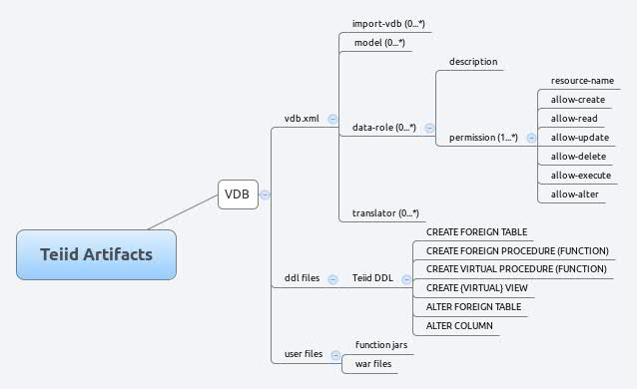
Komodo VDB Artifact
TBD...

Slide 9
Current Architecture
JBoss Developer Studio
Application Server
Teiid Designer
Teiid
Teiid Admin API
JNDI Data Sources (-ds.xml)
Models
VDBs
deploy VDB
create or select -ds.xml
select translator
deploy data source
Translators
.ddl files
VDBs
JDBC
DDL
WSDL
etc...
Import
Teiid JDBC
Connection
Eclipse Data Tools
Test/Query
Connection Profiles
Data Sources

Slide 10
Komodo Architecture
JBoss Developer Studio
Application Server
Teiid Designer
Teiid
Teiid Admin API
JNDI Data Sources (-ds.xml)
Models
VDBs
deploy VDB
create or select -ds.xml
select translator
deploy data source
Translators
.ddl files
VDBs
JDBC
DDL
WSDL
etc...
Import
Teiid JDBC
Connection
Metadata Via Teiid Connection
- Data Source Deployment
- Dynamic Source VDB
Test/Query/Import
Data Sources

Slide 11
Integration Points
Teiid
  Admin API (deploy/undeploy artifacts)
  Query parsing, resolving and validation (Client-side?)
Polyglotter
  Embedded/common Modeshape repository
  Leverage Modeshape modeler engine
  Teiid DDL metamodel (MS ddl-sequencer)
  Artifact publishing/management via SRAMP

Slide 12
New Features
Data Source Configuration Management
  Common metamodel (MS CND definition)
  Connection Profiles (Eclipse Data Tools ?)
  Data Sources (Resource Adapters?)
  Import Properties
Translator Overrides
  Common metamodel (MS CND definition)
  Re-usable
Community Repository
  Documentation
  Example projects/VDBs
  Example data sources
  Example Schema (DDL)

Slide 13
Komodo Development Timeline
TBD...

